Slide 1

Intro to Kubernetes

Slide 2
Timing
Introduction 10-10:10
Ex 0 (must be already done) 10:10-10:20
Containers 10:20-10:30
Container registry 10:30-10:40
Ex 1 10:40-10:50
Orchestrator 10:50-11:10
Ex 2 11:10-11:20
K8s fundamentals 11:20-11:40
Ex 3 11:40-12
Networking 12-12:30
Lunch 12:30-13:30
Ex 4 13:30-13:45
Security 13:45-14
Scaling 14-14:10
Ex 5 14:10-14:30
Storage 14:30-14:50
Ex 6 14:50-15:20
We need to finish at xxxx??

Slide 3


Speakers' introduction
Jessica Tibaldi
App Solution Engineer
Fabrice Krebs
Infra Solution Engineer

Slide 4
Scope
What we will discuss today
AKS basics and how to use it
Main customer objections/pain points in adopting AKS
Differences between container options in Azure
…
What is not in scope
App Modernization
AI (sorry! :o) )

Slide 5
Lab Scenario
Customer has existing containerized microservices and they want to run it in containers in the cloud
Customer is asking you to help them with this process
You will complete a PoC with a sample app, to show to the customer how to operationalize it

Slide 6
Sample App
Simple Node.js application
Two components:
Frontend
Web site with a single page to managed tasks
Backend
Middleware for accessing the tasks storage
Health check endpoint
Load Testing

Slide 7
Journey to Kubernetes
Here’s our roadmap for the hack
Containerizing an existing app
What is a Container Registry
What is Container Orchestrator? (Hint: It’s what you’re here for today!)
Kubernetes Fundamentals (Pods, Deployments, & Services, oh my!)
Scaling
Networking
Storage
DevOps
HA & DR
Monitoring

Slide 8

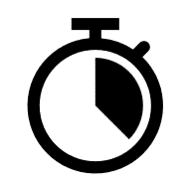
Exercise 0
Ready, Set, GO!!! Get ready to start!
Review the exercise-0
Configure the jumphost on Azure (RECOMMENDED)
If you prefer to proceed on your local machine, check pre-requirements
10 min
Notes:
Convince the audience they should become developers and install tools locally!

Slide 9
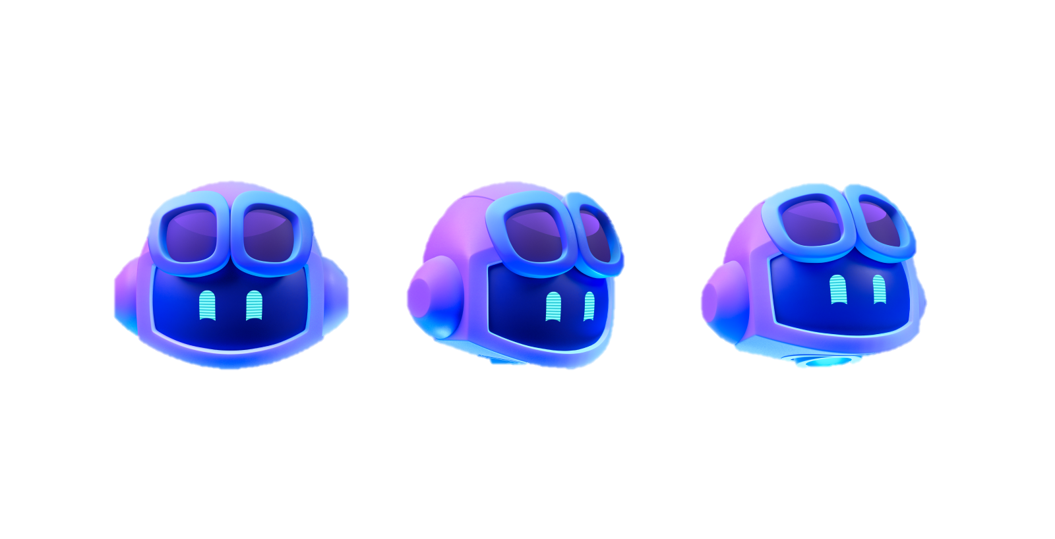
Remember:
Using Github Copilot is not cheating

Slide 10
Introducing Containers

Slide 11
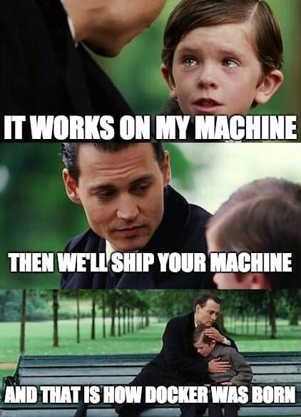
Review: What is a Container?

Slide 12
What is a Container?
VM
VM
VM
VM
App A
App B
App C
Guest OS
Guest OS
Guest OS
Guest OS
Hypervisor
Hypervisor
Host OS
Host OS
Server
Server
Notes:
Let’s start by reviewing what a Virtual Machine is…
We have a physical server which runs a Host OS (Linux or Windows)
The Host OS runs a Hypervisor (Hyper-V, VMWare, etc)
The Hypervisor can then run one or more Virtual Machines.
A Virtual Machine (the yellow box) is given an isolated & allocated set of resources from the underlying physical server (CPU, Memory, Storage)
The Virtual Machine runs a “Guest OS” (Windows or Linux)
The VM can then have software installed on to it.
The VM is stored as an IMAGE file, which can then be transferred and run on any other physical server with the same hypervisor.
In Azure, image files are called VHDs. In AWS they are called AMIs.
VM Characteristics:
VMs are portable.
Multiple VMs running on the same physical servers enable organizations to achieve greater density and use of those physical resources.
VMs are the “unit of deployment” which enabled Cloud Computing to be possible.
VMs take multiple minutes to deploy and start up
Typically, VMs are dedicated to having a single app.
This is to avoid functional conflicts that happen between apps.
For example:
If App A & App B are deployed onto the same VM and use a shared library, if one app updates the shared library, it could cause the other app to fail. Let’s take a look at containers and the benefits they bring to the table…

Slide 13
What is a Container?
VM
VM
VM
VM
App A
App B
App C
Guest OS
Guest OS
Guest OS
Container Engine
Guest OS
Hypervisor
Hypervisor
Host OS
Host OS
Server
Server
Notes:
On the right, we have a single VM with a Guest OS on it.
We add a “container engine”.
The container engine acts similar to a hypervisor within the OS, except instead of VMs, it lets us run containers.

Slide 14
What is a Container?
VM
VM
VM
VM
App A
App B
App C
Container
App A
Guest OS
Guest OS
Guest OS
Bins/Libs
Container Engine
Guest OS
Hypervisor
Hypervisor
Host OS
Host OS
Server
Server
Notes:
Here’s a container (in the blue blox).
Containers are a method of operating system virtualization that allow you to run an application and its dependencies in resource-isolated processes
A container allows you to package up an application and all of its dependencies (libraries, etc) into an IMAGE file.
Like a VM, the great thing about Containers are that they are PORTABLE.
Once you have a container image, you can deploy that container to any VM with the same container engine and it should “just work”.
When you run a container, it starts up almost instantly. Usually within seconds, not minutes.
This brings a lot of benefits… (next slide)

Slide 15
What is a Container?
VM
VM
VM
VM
App A
App B
App C
Container
Container
Container
App A
App B
App C
Guest OS
Guest OS
Guest OS
Bins/Libs
Bins/Libs
Bins/Libs
Container Engine
Guest OS
Hypervisor
Hypervisor
Host OS
Host OS
Server
Server
Notes:
Apps don’t step on each other (because they each have their own copy of any shared libraries)
Apps/containers can be updated independently of each other.
This allows us to slice up the OS and run multiple apps on a single VM! Achieving better density and use of resources.
NOTE:
While apps won’t step on each other functionally, they CAN compete for resources within the VM (CPU/Memory)
Containers are OS-specific. While portable, in general:
Windows containers can only run on Windows VMs
Linux containers can only run on Linux VMs*
* - It IS technically possible to run Linux containers on Windows with developer tools, however, they are usually run on Linux VMs in production environments.
Every container has an isolated view and gets
Own root directory
eth0 network interface
its own PID0
Kernel features to accomplish this:
cgroups: limiting what you can use
namespaces: limiting what you can view
When running containers on a VM, you need to manually configure access to them with a tool like HAProxy or Nginx.

Slide 16

What is a Container?
VM
VM
VM
VM
App A
App B
App C
Container
Container
Container
App A
App B
App C
Guest OS
Guest OS
Guest OS
Bins/Libs
Bins/Libs
Bins/Libs
Container Engine
Guest OS
Hypervisor
Hypervisor
Host OS
Host OS
Server
Server
Notes:
Let’s replace the generic term “Container Engine” with “docker”
“docker” has become the defacto industry standard for running containers.
“docker” lower case D is an open source project that has become the industry standard for running containers.
Docker (upper case D) is a commercial company.
Explain what docker vs. Docker is.
Explain that containerd, a new open container engine implementation is gaining a lot of traction as seen at KubeCon
Microsoft is actually replacing docker with containerD in AKS.

Slide 17

What is a Container?
VM
VM
VM
VM
App A
App B
App C
Container
Container
Container
App A
App B
App C
Guest OS
Guest OS
Guest OS
Bins/Libs
Bins/Libs
Bins/Libs
Guest OS
Hypervisor
Hypervisor
Host OS
Host OS
Server
Server
Notes:
Microsoft is actually replacing docker with containerD in AKS.

Slide 18
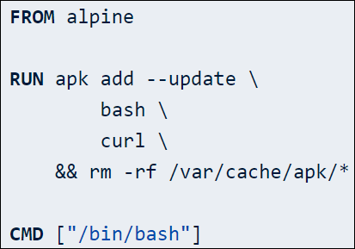
Dockerfile
Image Name
Captures the Steps to build a container
Is a version-able asset in your DevOps flows
Configuration As Code
Re-use of Existing Container Images (Private or Public)
Initializes a new build stage and sets the base image
Execute commands in a new layer on top of the current image and commit results
Provide defaults for an executing container
Process started in an executing container
Notes:
Old skule Unix/C Makefiles
DSL to build
FROM, RUN, CMD
Also: copy files, open ports, attach storage

Slide 19

Exercise 1
Containerize your app!
Already done for you ☺

Slide 20
What is a Container Registry?

Slide 21
What is a Container Registry
Discover your containers
A place to store, list, and share your container images
Like an “app store” for container images
DockerHub is a registry hosted by Docker. Many companies publish their containers there.
Most cloud providers offer their own Cloud Registries “as-a-service”
Azure has the… “Azure Container Registry”!
Docker tools can publish to a container registry
Docker can run a container image from a registry

Slide 22
What is a Container Registry?
VM
Container
Container
Container
Container Registry
App A
App B
App C
Container Image
Container Image
Bins/Libs
Bins/Libs
Bins/Libs
Container Image
Container Engine
Container Image
Guest OS
Container Image
Hypervisor
Container Image
Host OS
Server
Notes:
Let’s take a look at this visually.
Here you see the docker container engine communicates with the Container Registry to PUSH or PULL container images.

Slide 23
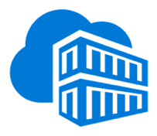
What is a Container Registry?
VM
Container
Container
Container
Container Registry
Azure Container Registry
hub
App A
App B
App C
Container Image
Container Image
Bins/Libs
Bins/Libs
Bins/Libs
Container Image
Container Engine
Container Image
Guest OS
Container Image
Hypervisor
Container Image
Host OS
Server
Notes:
DockerHub is the public container registry from Docker
Azure Container Registry is a PaaS service from Azure that gives you a private registry to use with in an organization.
ACR is compatible with the docker CLI tool, so all of the standard docker commands (push, pull, etc) work with ACR.
This can be done securely using AAD authentication.

Slide 24
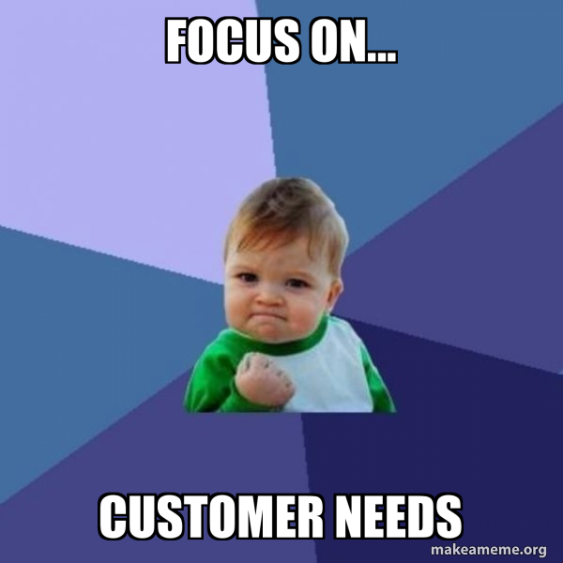
What customers want
Private network!!!
Reliability
zone redundancy
geo-replication
Mirroring of existing repos
Caching options
Security
Access control, permissions
Vulnerability assessment
Multi-environment/team considerations

Slide 25
Exercise 1
Publish your containers to a registry
Create an Azure Container Registry
Set up your permissions properly
Publish your backend & frontend containers to ACR
10 min

Slide 26
Okay, I’ve got containers. And a registry. Now what?!

Slide 27
I’m going to want more VMs with containers!
VM
VM
Container
Container
Container
Container
Container
Container
App A
App B
App C
App A
App B
App C
Bins/Libs
Bins/Libs
Bins/Libs
Bins/Libs
Bins/Libs
Bins/Libs
Container Engine
Container Engine
Guest OS
Guest OS
Hypervisor
Hypervisor
Host OS
Host OS
Server
Server
Notes:
I’m going to want to optimize and scale!

Slide 28
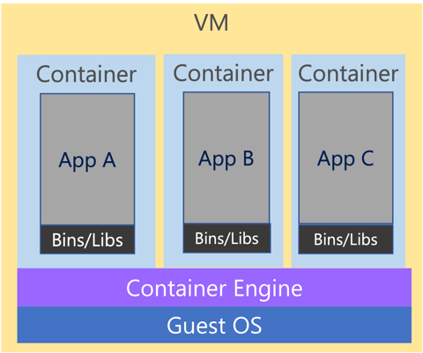
And more… and more!

Slide 29

And more… and more… CHAOS!
Notes:
You can imagine there are a lot of problems as you run containers at scale:
Scheduling (how many instances of each container to run and where)
Scaling up/down
Replacing dead containers
Version updates
Etc
You’re going to need help with this!

Slide 30
What is a Container Orchestrator?

Slide 31
What is a Container Orchestrator?
Container Orchestrator
Notes:
Let’s introduce a container orchestrator to the picture!
What is a container orchestrator?
It’s just another piece of software…

Slide 32
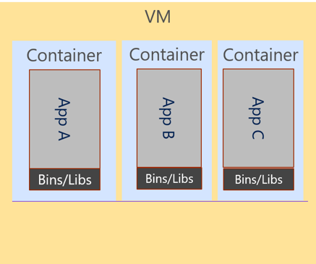
What is a Container Orchestrator?
Cluster
Container Orchestrator
Notes:
It is software that acts as a control plane to manage a “cluster” of VMs and the deployment of containers on it.
All of those scale problems mentioned earlier can be handled by a container orchestrator.

Slide 33
What is a Container Orchestrator?
Cluster
VM
Container Orchestrator
Guest OS
Hypervisor
Host OS
Server
Notes:
The Container Orchestrator is just another piece of software that runs on a VM itself.

Slide 34
What is a Container Orchestrator?
Container orchestrators group hosts together to form a cluster, and fulfill these requirements:
Are fault tolerant
Can scale on demand
Use resource optimally
Discover other applications automatically
Accessible from the external world
Updates and roll-backs without downtime
Notes:
Container orchestrators help with a long list of challenges

Slide 35
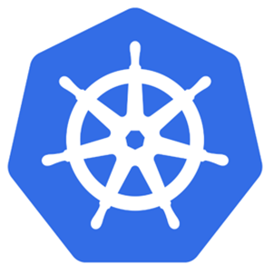
Kubernetes is a Container Orchestrator!
Cluster
VM
Kubernetes
Guest OS
Hypervisor
Host OS
Server
Notes:
Kubernetes IS a container orchestrator.
There have been quite a few other container orchestrators on the market.
DC/OS/Mesosphere
Docker Swarm
Azure Service Fabric is a container orchestrator!
K8S: This is the orchestrator we focus on and safe to say it is the de-facto standard for container orchestrators

Slide 36
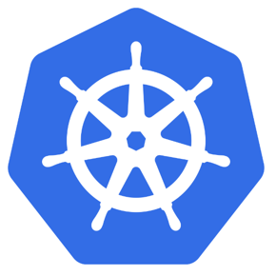
What is Kubernetes?
"Kubernetes is an open-source system for automating deployment, scaling, and management of containerized applications."
Kubernetes comes from the Greek word κυβερνήτης:, which means helmsman or ship pilot, ie: the captain of a container ship.

Slide 37
Why K8s for Kubernetes?
The word Kubernetes has 10 letters.
To abbreviate it, people kept the first letter K, the last letters, and replaced the 8 letters in between with the number 8
It is called : numeronym

Slide 38
How Kubernetes works
Kubernetes control
Worker node
kubelet
kube-proxy
Internet
The control plane provides the core Kubernetes services and orchestration of application workloads
Control Plane
Docker
Kubernetes users communicate with API server and apply desired state
Pod
Pod
API server
Containers
Containers
Controllers enforce desired state on worker nodes
-controller-manager
-scheduler
Worker nodes are the underlying VMs that run applications
Worker node
kubelet
kube-proxy
Internet
Worker nodes support communication between containers and from the Internet
replication, namespace, serviceaccounts, etc.
etcd
Docker
Pods run a set of containers with shared storage and network resources
Pod
Pod
Containers
Containers
Notes:
Kubernetes has a "hub-and-spoke" API pattern
Kubectl cmds talk to api server, other components live on masters
Workers are what you care about, masters provision workers and use Kubelets to keep everything connected
Docker is the software that keeps a container up and running but kubernetes is what orchestrates all the containers together
There are two primary communication paths from the control plane (apiserver) to the nodes. The first is from the apiserver to the kubelet process which runs on each node in the cluster. The second is from the apiserver to any node, pod, or service through the apiserver's proxy functionality
The connections from the apiserver to the kubelet are used for:
Fetching logs for pods.
Attaching (through kubectl) to running pods.
Providing the kubelet's port-forwarding functionality.

Slide 39
Kubernetes has a “Control Plane” & Cluster of “Nodes”
Cluster
VM
Control Plane Node
Kubernetes
Node
Node
Node
Node
Node
Node
Guest OS
Hypervisor
Host OS
Server
Notes:
The Kubernetes control plane has historically been referred to as the “master” or “master node”.
You may see references to it in documentation this way.
However, it is commonly referred to as the “Control Plane” lately
From here on out, we shall use the Kubernetes vocabulary.
Node = VM

Slide 40
How Kubernetes works on Azure
Node Pool
Kubernetes control
Worker node
kubelet
kube-proxy
Internet
Control Plane is fully managed by Microsoft
Kubernetes RBAC
+
Microsoft Entra ID
Worker nodes grouped in node pools, are provided with OS, Container Runtime and all the Kubernetes components configured
Control Plane (managed by Microsoft)
Docker
Pod
Pod
API server
Containers
Containers
Kubernetes RBAC can be integrated with Microsoft Entra ID
-controller-manager
-scheduler
Worker node
kubelet
kube-proxy
Internet
Compute, networking and storage configuration leverage Azure infrastructure
replication, namespace, serviceaccounts, etc.
etcd
Docker
Pod
Pod
Auto Upgrade
Node Auto repair
Zonal and Regional resiliency
Control Plane SLA 99.95%
Native backup integration
Containers
Containers
Notes:
Kubernetes has a "hub-and-spoke" API pattern
Kubectl cmds talk to api server, other components live on masters
Workers are what you care about, masters provision workers and use Kubelets to keep everything connected
Docker is the software that keeps a container up and running but kubernetes is what orchestrates all the containers together
There are two primary communication paths from the control plane (apiserver) to the nodes. The first is from the apiserver to the kubelet process which runs on each node in the cluster. The second is from the apiserver to any node, pod, or service through the apiserver's proxy functionality
The connections from the apiserver to the kubelet are used for:
Fetching logs for pods.
Attaching (through kubectl) to running pods.
Providing the kubelet's port-forwarding functionality.

Slide 41
Azure Kubernetes Service (AKS)
AKS reduces the complexity and operational overhead of managing Kubernetes by offloading much of that responsibility to Azure.
You only pay for the agent nodes within your clusters, not for the control plane nodes

Slide 42
AKS is Kubernetes (Control Plane) as a Service
Cluster
Kubernetes
Control Plane
Node
Node
Node
Node
Node
Node
Notes:
The nodes running your containers are regular Azure VMs that you pay an hourly rate for. You will see these referred to as “worker nodes” or “agent nodes”.
A group of nodes of the same type (VM SKU size) is referred to as a “nodepool” in Kubernetes. AKS implements all nodes as Azure VMs in an Azure VM Scale Set. Thus, in Kubernetes:
Node = Azure VM
Nodepool = Azure VM Scale Set

Slide 43
Azure Kubernetes Service (AKS)
Azure Kubernetes Service (AKS)
Get started easily
$ az aks create -g myResourceGroup -n myCluster --generate-ssh-keys
\ Running ..
$ az aks install-cli
Downloading client to /usr/local/bin/kubectl ..
$ az aks get-credentials -g myResourceGroup -n myCluster
Merged "myCluster" as current context ..
$ kubectl get nodes
NAME STATUS AGE VERSION
aks-mycluster-36851231-0 Ready 4m v1.8.1
aks-mycluster-36851231-1 Ready 4m v1.8.1
aks-mycluster-36851231-2 Ready 4m v1.8.1
Notes:
AKS has integrated the Kubernetes CLI (kubectl) with the Azure CLI.
These next two slides are examples of how they work together.
Pay no attention, as you will discover this in the next challenge!

Slide 44
Azure Kubernetes Service (AKS)
Azure Kubernetes Service (AKS)
Manage an AKS cluster
$ az aks list –o table
Name Location ResourceGroup KubernetesRelease ProvisioningState
------------------ ---------- -------------- ------------------- -------------------
myCluster westus2 myResourceGroup 1.7.7 Succeeded
$ az aks upgrade -g myResourceGroup -n myCluster –-kubernetes-version 1.8.1
\ Running ..
$ kubectl get nodes
NAME STATUS AGE VERSION
aks-mycluster-36851231-0 Ready 12m v1.8.1
aks-mycluster-36851231-1 Ready 8m v1.8.1
aks-mycluster-36851231-2 Ready 3m v1.8.1
$ az aks scale -g myResourceGroup -n myCluster --agent-count 10
\ Running ..

Slide 45
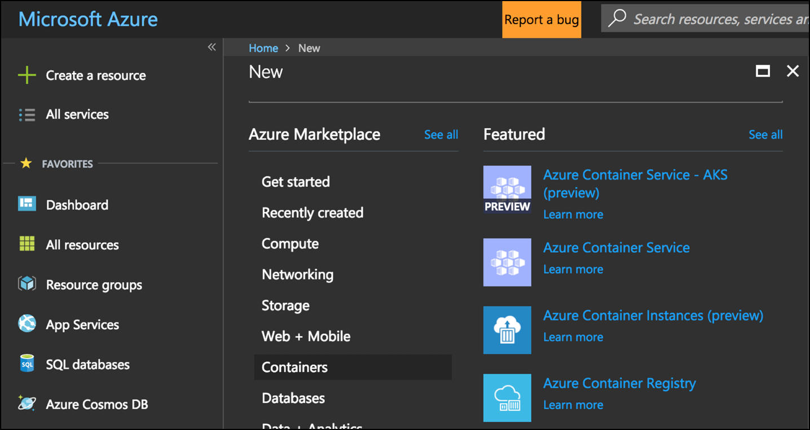
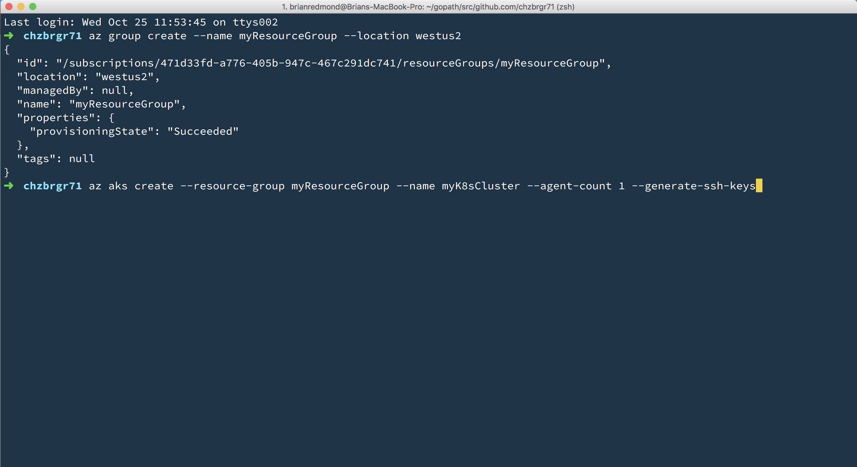
Azure Kubernetes Service (AKS)
Azure Kubernetes Service (AKS)
Create AKS via Portal, Azure CLI, or ARM template

Slide 46
Comparison between container managed services on Azure

Slide 47
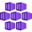


Containers | Azure Ecosystem
Azure Kubernetes Service
Azure Container Apps
Azure RedHat Openshift
Used for
Containerized applications, APIs, and microservices
Language/OS
Any language Linux and Windows containers
Any language Linux containers
Any language Linux and Windows containers
Networking
Flexibility in choosing networking model
Requires consideration on address ranges
Internal/external access via ingress or gateway and Azure Load Balancer or Azure Application Gateway
Integration with Azure private DNS zone for custom configuration
Internal Environment with private IP only served by Azure Load Balancer
Custom DNS and certificate
Integration with Azure Front Door/Application Gateway
Advanced, enterprise-grade OpenShift SDN / OVN
Strict network policies and secure defaults (SELinux, SCCs)
Private clusters, VNet integration, hybrid networking support
Developer experience
Deploy containers using Kubernetes YAML files trough kubectl
Use Deployment Center to integrate with GitHub Actions.
Use open-source and CNCF projects like Istio, Knative, and ArgoCD, Tekton.
Use select built-in (managed) projects like KEDA, Dapr, and Azure ML.
Deploy containerized applications or integrate with GitHub Actions.
Use built-in Dapr for microservices communication, pub/sub, etc.
Rely on built-in application lifecycle management features such as revisions and traffic shifting.
Container Environment = k8s namespace / Container App = k8s deployment
Deploy containers using Kubernetes YAML files though oc CLI
Use built-int deployment provided in the internal marketplace
Source2Image for deployment without Dockerfile and YAML definition
Internal Openshift Pipelines powered by Tekton for CI/CD
Operator experience
Use Kubernetes native APIs/Azure portal to create and manage workloads.
Integrate with Azure services like Container Registry.
Configure scaling using cluster autoscaler and Node Automatic Provisioning.
Apply governance policies using Azure Policy.
Shared responsibility in maintenance
Use Azure APIs/portal to create a container app environment which hosts multiple apps.
Define scaling parameters using KEDA with scale-to-zero support.
No access to underlying k8s APIs
Red Hat and Microsoft jointly support the OpenShift platform
Integrate with Azure services like Container Registry
Apply governance policies using Azure Policy.
Shared responsibility in maintenance
Notes:
Azure App Platform.pptx
Considerations:
App Service does not support private DNS zone for custom DNS (ref prerequirements → Map existing custom DNS name - Azure App Service | Microsoft Learn) only in ILB App Service Environment but costs are too high for this configuration
Private IP only for App Gateway is currently in preview
Azure Functions could be deployed as container in Elastic Premium Plan and Dedicated Plan
Azure Functions follow App Service, ACA or AKS configuration for custom DNS based on where they are deployed – not supported on Consumption Plan

Slide 48




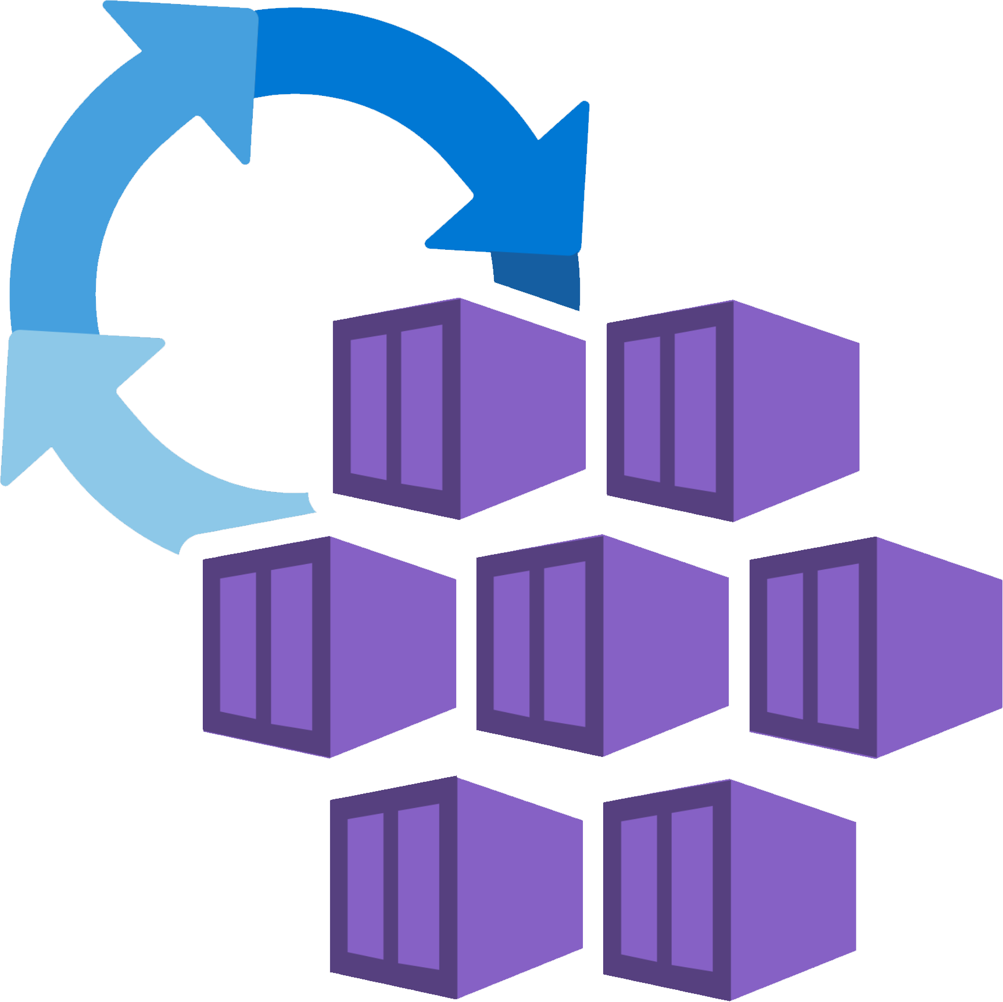

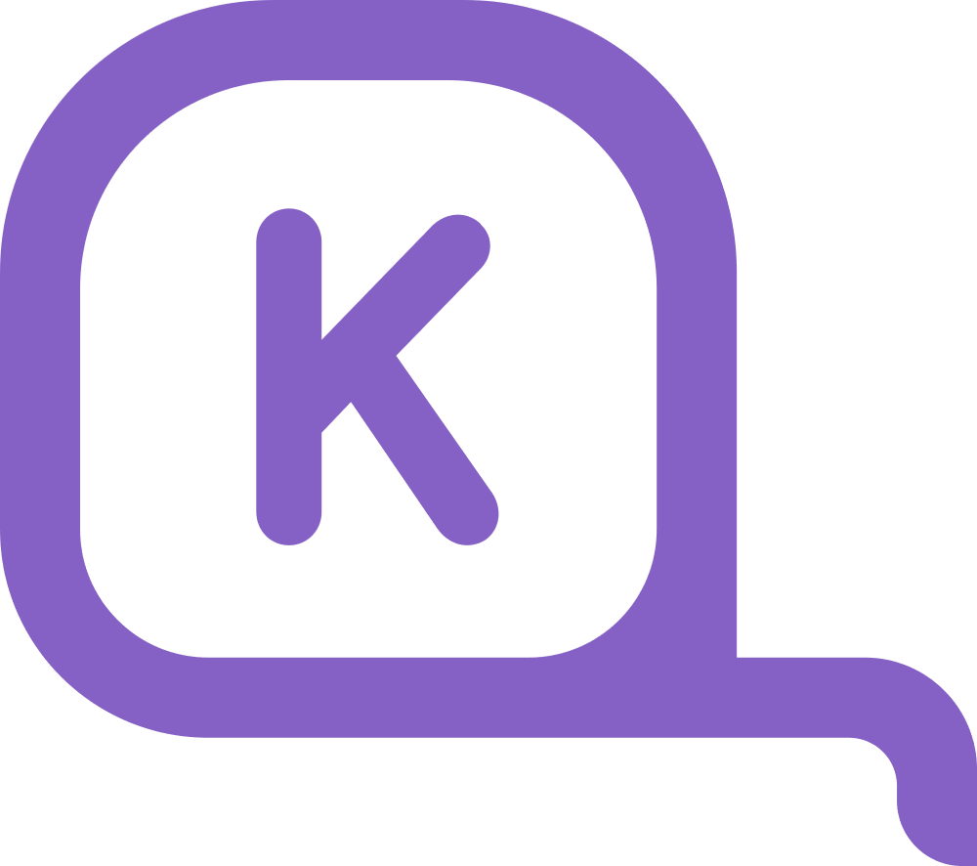






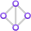




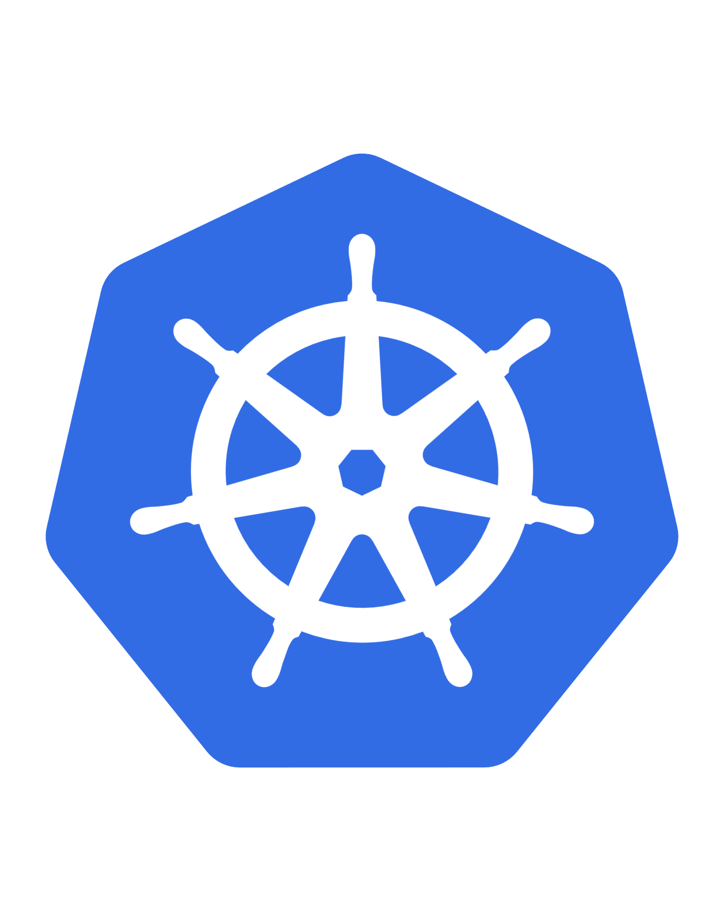


The easiest Kubernetes experience for developers and operators
Preconfigured
Networking
Compute
Security
Observability
Built in network policy engine
Bin-packing for cost optimization and scaling
Entra ID RBAC
Built-in dashboards
Managed ingress
Azure Linux lightweight OS
Locked down nodes
Automatic node repair
API server and nodes communicate over a private network
Built-in security enforcements
Automatic
Support GPU nodes
Metrics collection
Uptime SLA
Automatic upgrades
Logs collection
Safeguards
Best practices enforced through Azure policy
Learn more: https://aka.ms/aks/automatic
Notes:
To address this, we created AKS Automatic, the easiest K8s experience for developers and operators. AKS Automatic is built to simplify running Kubernetes by coming pre-configured with best practices for networking, compute, and security, and abstracting away all of the configuration knobs. This will let newcomers who are frequently overwhelmed by Kubernetes get started quickly without having to worry about configuration. AKS Automatic also has safeguards in place that prevent, and in some cases, solve, many of the common workload configuration issues that result in reliability or security problems

Slide 49
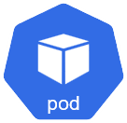



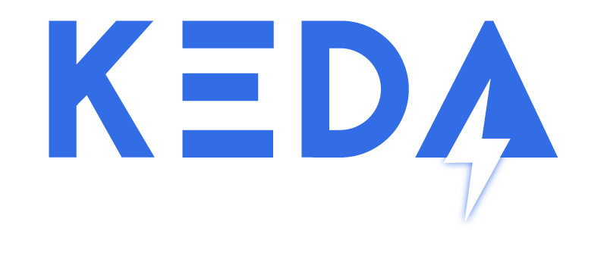

Scaling? Let AKS Automatic scale your applications
Picks the right-sized compute to satisfy workload requirements while continuously bin-packing to reduce your costs.
D2s_v6
Node auto provisioning
Karpenter
D2pls_v6
E2s_v6
Pods
Vertical Pod Auto-scaler
Dynamically updates the requests and limits based on usage metrics.
Update resource requests and limits
Kubernetes Event Driven Auto-scaler (KEDA)
Event-based scaling that works with 70+ built-in scalers such as Service Bus, Event Hub, Azure Monitor, Prometheus, Redis, and more.
Trigger
Metrics Adapter | Scaler | Controller
HPA
Notes:
- NAP pick the most cost effective skew for your workloads based on pending pod requirements.
VPA: scales the size of the pod via updating resource request and limit values for memory and CPU based on historical utilization
KEDA: extends HPA to scale the number of pods needed based on event triggers. You're over 70 built-in scalers for KEDA

Slide 50
AKS vs AKS Automatic
Aspect | AKS Automatic | Manual AKS
Operational Overhead | Low – automation reduces manual tasks (scaling, upgrades, repairs). | High – requires constant monitoring and manual intervention.
Control | Limited – upgrade cadence and repair logic follow Azure defaults. | Full – you decide when and how to scale, patch, and upgrade.
Security & Compliance | Strong – auto-upgrade channels ensure timely patches. | Risk of delays – manual patching can lead to vulnerabilities.
Cost Management | Dynamic – autoscaler optimises resources but may cause cost spikes. | Predictable – fixed node count, but risk of over-provisioning.
Response to Demand | Fast – HPA and autoscaler react automatically to workload changes. | Slow – manual scaling may lag behind sudden spikes.
Complexity | Lower day-to-day ops, but debugging automation issues can be harder. | Higher operational complexity, but easier to troubleshoot manually.
Customisation | Limited – automation settings are predefined by Azure. | High – tailor scaling logic, upgrade strategy, and node behaviour.
Risk of Human Error | Low – automation reduces manual mistakes. | High – manual processes prone to errors and missed updates.
Notes:
Azure App Platform.pptx
Considerations:
App Service does not support private DNS zone for custom DNS (ref prerequirements → Map existing custom DNS name - Azure App Service | Microsoft Learn) only in ILB App Service Environment but costs are too high for this configuration
Private IP only for App Gateway is currently in preview
Azure Functions could be deployed as container in Elastic Premium Plan and Dedicated Plan
Azure Functions follow App Service, ACA or AKS configuration for custom DNS based on where they are deployed – not supported on Consumption Plan

Slide 51
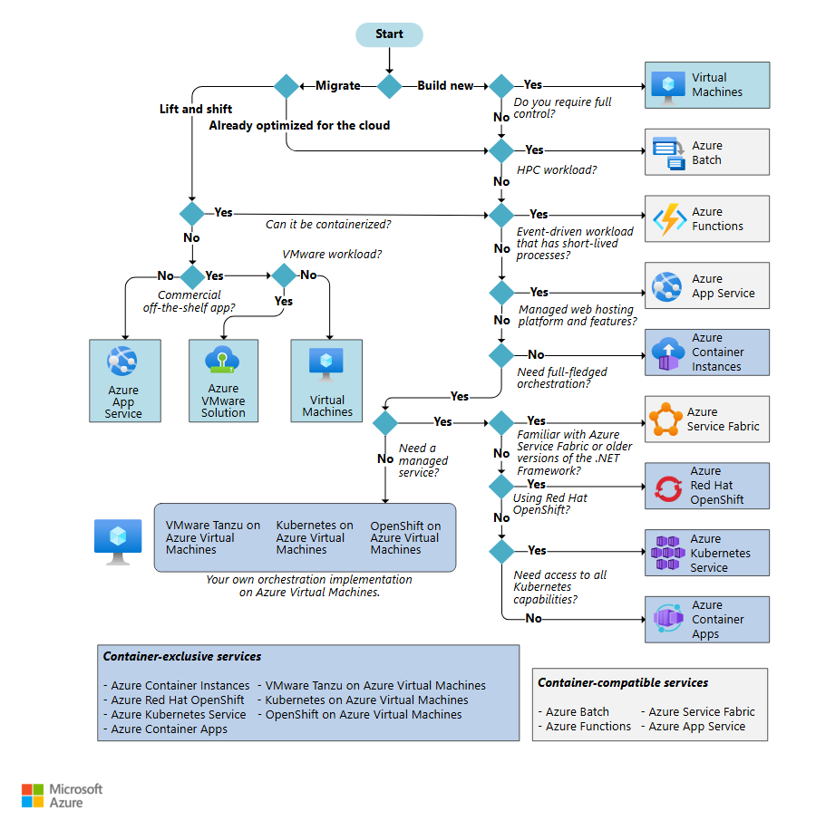

How to guide customers in choosing the right service

Slide 52
Exercise 2
Create a Kubernetes Cluster
Create a new AKS cluster from the command line or the portal
Use kubectl or the portal to prove that the cluster is working
10 min

Slide 53
Kubernetes Fundamentals
Pods, Deployments, Services…. Oh My!

Slide 54
Kubernetes @ 10,000ft
Cluster
Kubernetes
Control Plane
Node
Node
Node
Node
Node
Node
Notes:
Kubernetes is full of many complexities.
Sometimes, to learn something really complex, you need to start by focusing on the simplest parts…

Slide 55
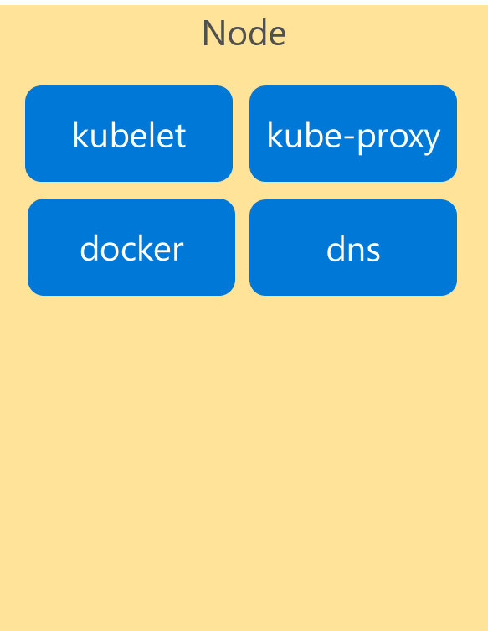
Kubernetes Architecture Components
Cluster
Control Plane
Node
api-server
kubelet
kube-proxy
controller-manager
docker
dns
etcd
scheduler
*Azure Managed
Notes:
If we look inside the VM nodes in a Kubernetes clusters, we’ll see a whole set of services that are running on each.
These are containers themselves!
These services are how Kubernetes handles management of the nodes and things that run on them.
I’m going explain these now briefly…

Slide 56
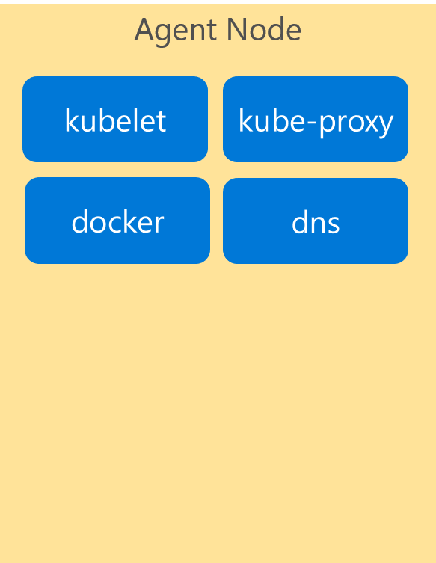
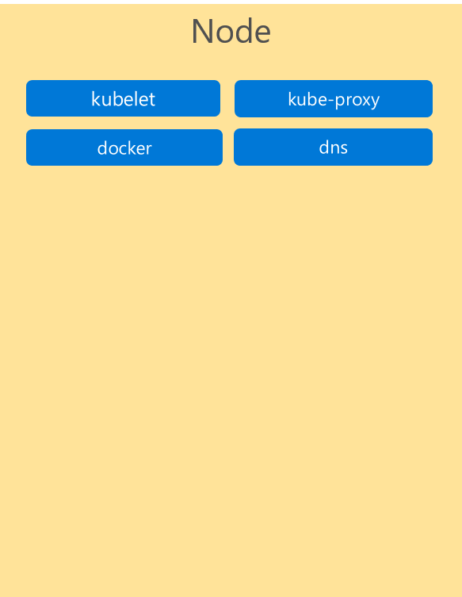
Kubernetes Architecture Components
Cluster
Control Plane
Node
Kube stuff
Kube stuff
api-server
kubelet
kube-proxy
docker
dns
controller-manager
etcd
scheduler
*Azure Managed
Notes:
…by telling you to forget about ALL of them for now!
They’re just the stuff that makes Kubernetes run.
You can read all about them in the docs, and probably will learn more about them as you become more familiar with the system.
But for today… we want to focus on the core components and concepts.
IF you focus on these, you’ll get lost.
Let’s keep it simple for now.

Slide 57
Kubernetes Architecture Components
Where do the Containers go?
Container
Container
Container
App A
App B
App C
Bins/Libs
Bins/Libs
Bins/Libs
Notes:
Containers are the only thing that run.
<click>

Slide 58
Kubernetes Architecture Components
Introducing… Pods!
Pod
Pod
Pod
Container
Container
Container
App A
App B
App C
Bins/Libs
Bins/Libs
Bins/Libs
Containers go inside Pods!
Notes:
K8S wraps container in a layer of metadata
A POD

Slide 59
Kubernetes Architecture Components
Pods
Cluster
Control Plane
Node
Kube stuff
Kube stuff
api-server
kubelet
kube-proxy
docker
dns
controller-manager
Pod
App A
Pod
App B
Pod
App C
etcd
scheduler
*Azure Managed
Notes:
Here are some pods running on one node in our cluster

Slide 60
Kubernetes Architecture Components
Pods
Cluster
Control Plane
Node
Kube stuff
Kube stuff
kubelet
kube-proxy
api-server
docker
dns
Pod
App A
Pod
App B
Pod
App D
controller-manager
Pod
App A
Pod
App B
Pod
App C
etcd
scheduler
Pod
App C
Pod
App C
*Azure Managed
Notes:
Here are some pods running across multiple nodes on our cluster…
You can see we have different numbers of each type of pod running.
One benefit of Kubernetes is that it is easy to independently scale each container/app.

Slide 61
Pods – What are they?
Metadata. They’re just metadata!
Metadata that describes how the containers are configured.
pod
pod
ratings-web
Label(s) | app=ratings-web
Container-image | my.azurecr.io/ratings-web
Port | 3000
(VolumeMount) | /mnt/share
(Resources) | <cpu/memory>
ratings-api
Label(s) | app=ratings-api
Container-image | my.azurecr.io/ratings-api
Port | 3001
(VolumeMount) | /mnt/share
(Resources) | <cpu/memory>
pod
otherApp
Label(s) | app=otherApp
Container-image | other.azurecr.io/otherApp
Port | 4045
(VolumeMount) | /mnt/share
(Resources) | <cpu/memory>
Notes:
Pods are metadata that define how the container will be hosted.
What is that metadata
Image – link to the container registry & container name
Port – port number this pod should listen to traffic on
Storage/resources
Label=important => Labels are the most important concept in Kubernetes. Kubernetes keeps a database of all of the configuration information. The “label” you give to a Pod makes it possible for Kubernetes to keep track of all instances of that type of pod running in the cluster.
<click>more<click>more

Slide 62
Deployments
More Metadata
Metadata that describes how to deploy a pod
Deployment
ratings-web
replicas | 2
pod
ratings-web
Label(s) | app=ratings-web
Container-image | my.azurecr.io/ratings-web
Port | 3000
(Volume) | …
(Resources) | …
Notes:
How do I deploy a pod?? With a deployment. Again, more metadata.
In Kubernetes, an instance of a pod is called a “replica”.
Just like VMs are called nodes, instances are called “replicas”
Kubernetes is a language onto itself.
Replicas == scale == desired state (more on that later)
WHY you want one container per pod: Because pod is the unit of scale

Slide 63
Kubernetes Deployment in Action
Cluster
Control Plane
Node
Node
Kube stuff
Kube stuff
Kube stuff
kubelet
kube-proxy
kubelet
kube-proxy
docker
dns
docker
dns
Pod
ratings-web1
Pod
ratings-web2
Deployment
pod configuration
*Azure Managed
Notes:
Here is what that deployment looks like when it’s deployed to our cluster
NOTE: Make sure to mention pods get unique suffixes

Slide 64
Kubernetes Desired State In Action – Example 1
Cluster
Control Plane
Node
Node
Kube stuff
Kube stuff
Kube stuff
kubelet
kube-proxy
kubelet
kube-proxy
docker
dns
docker
dns
Pod
ratings-web1
Pod
ratings-web2
Deployment
pod configuration
Pod
ratings-web3
Notes:
What happens when a pod dies?
Kubernetes knows that our desired state is 2 replicas because we told it in our deployment.
So it will create a new pod

Slide 65
Kubernetes Desired State In Action – Example 2
Cluster
Control Plane
Node
Node
Kube stuff
Kube stuff
Kube stuff
kubelet
kube-proxy
kubelet
kube-proxy
docker
dns
docker
dns
Pod
ratings-web1
Pod
ratings-web2
Deployment
pod configuration
Pod
ratings-web3
Notes:
If we lose an entire node, Kubernetes will try to maintain the desired state of “2” replicas by scheduling a replacement pod on any other node that has capacity to run it.
There’s another Kubernetes term: “scheduling” == “deploying” a pod.
Side note: Respawning dead nodes is one of the things that AKS does for you, otherwise it would be a manual process of detection and remediation.

Slide 66
Services
Yet More Metadata!
Metadata that describes how to reach the pods
pod
ratings-web1
Label(s) | app-ratings-web
Container-image | my.azurecr.io/ratings-web
Port | 3000
Service
ratings-web
Selector | app=ratings-web
Port Mapping | 3000:8080
Type | Internal or External
pod
ratings-web2
Label(s) | app-ratings-web
Container-image | my.azurecr.io/ratings-web
Port | 3000
Notes:
Next concept: SERVICES
A load balancer for pods
Metadata that describes how to reach a pod, any number of replicas (instances).
Internal or External
<click then more details>

Slide 67
Kubernetes Service Deployment In Action
Services
Cluster
Control Plane
Node
Node
Kube stuff
Kube stuff
Kube stuff
kubelet
kube-proxy
kubelet
kube-proxy
docker
dns
docker
dns
Service
ratings-web
IP Address
Pod
ratings-web1
Pod
ratings-web2
Deployment
pod configuration
Service configuration
*Azure Managed
Notes:
Here’s a service in our cluster:
It is an abstract grouping of the pods running ratings-web
It has its own endpoint which proxies across the pods.

Slide 68
Kubernetes Service Deployment In Action
Services
Cluster
Control Plane
Node
Node
Kube stuff
Kube stuff
Kube stuff
kubelet
kube-proxy
kubelet
kube-proxy
docker
dns
docker
dns
Service
ratings-web
IP Address
Pod
ratings-web1
Pod
ratings-web2
Pod
ratings-api1
Pod
ratings-db1
Pod
someotherpod
*Azure Managed
Notes:
And here’s an example of other pods just running outside of the service

Slide 69
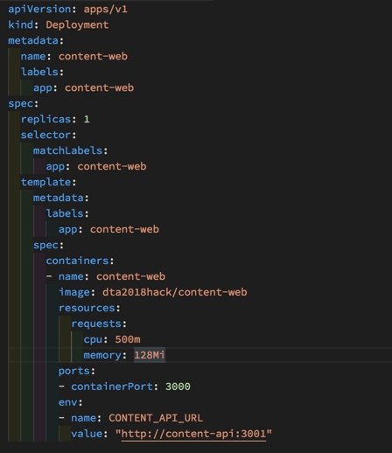
Deployments in Kubernetes
Infra-as-Code a YAML file
Tabs vs. spaces matter
Very sensitive to formatting: indentation, string vs not
Download the VS Code extension!
Notes:
For each container, you have TWO things to deploy…
deployment config
service config
Kubernetes config files are YAML format. (YAML == Yet Another Markup Language)
Easier than XML.
Easier than JSON.
But still picky on things like tabs vs spaces and line indentations.
If you use the VS Code extension for Kubernetes YAML files, you get great intellisense & code-completion.
This will help you avoid common syntax errors that only show up when you try to APPLY the config files.
Kubernetes is managed almost entirely via the Kubectl CLI tool.
Kubectl interacts directly with the Kubernetes Control Plane which manages the cluster.

Slide 70
Exercise 3
Deploy your microservices
Deploy the sample app services (frontend and backend)
20 min

Slide 71
Networking

Slide 72
Networking in Kubernetes
Kubernetes Networking model introduces 3 methods of communications:
Pod-to-Pod communication directly by IP address. Kubernetes has a Pod-IP wide metric simplifying communication.
Pod-to-Service Communication – Client traffic is directed to service virtual IP by iptables rules that are modified by the kube-proxy process (running on all hosts) and directed to the correct Pod.
External-to-Internal Communication – external access is captured by an external load balancer which targets nodes in a cluster. The Pod-to-Service flow stays the same.
Notes:
When the backend Service is created, the Kubernetes master assigns a virtual IP address, for example 10.0.0.1. Assuming the Service port is 1234, the Service is observed by all of the kube-proxy instances in the cluster. When a proxy sees a new Service, it installs a series of iptables rules which redirect from the VIP to per-Service rules. The per-Service rules link to per-Endpoint rules which redirect (Destination NAT) to the backends.
When a client connects to the VIP the iptables rule kicks in. A backend is chosen (either based on session affinity or randomly) and packets are redirected to the backend. Unlike the userspace proxy, packets are never copied to userspace, the kube-proxy does not have to be running for the VIP to work, and the client IP is not altered.
This same basic flow executes when traffic comes in through a node-port or through a load-balancer, though in those cases the client IP does get altered.

Slide 73
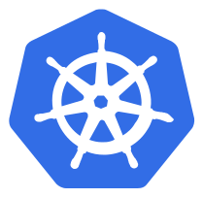
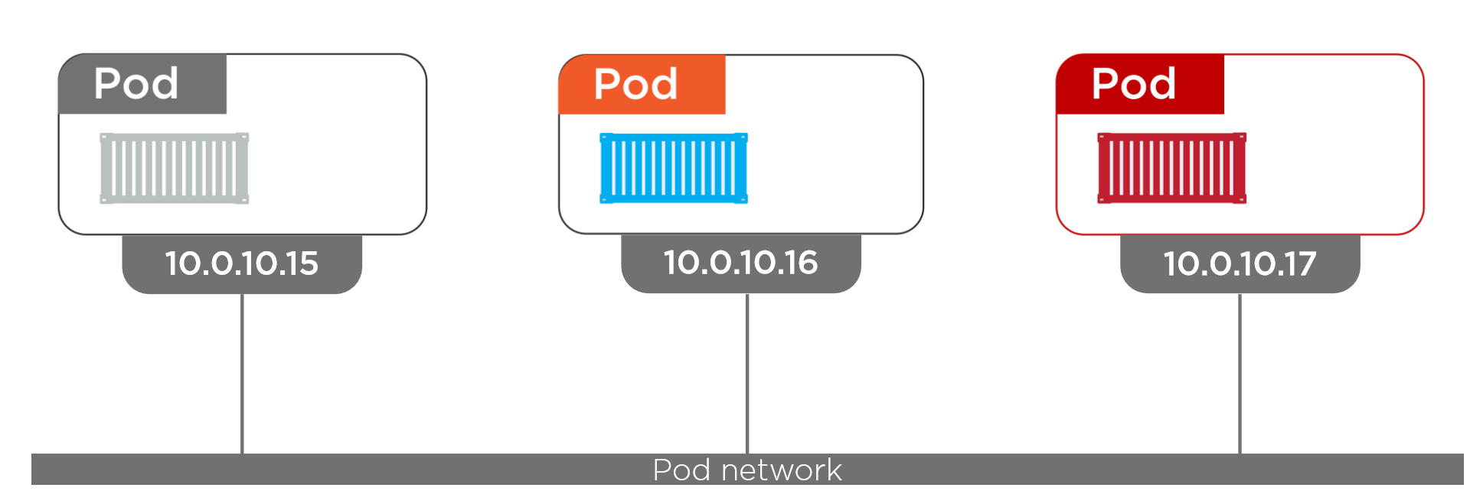
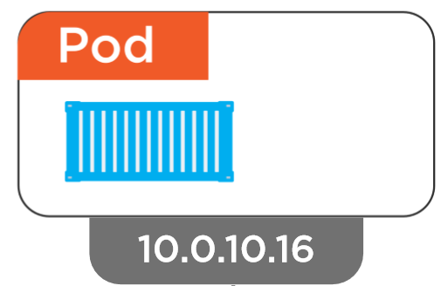
Networking - Pod
Inter-Pod Communication
Notes:
Pods are the unit of deployment in k8s
Each pod get an IP address and each pods can communicate each other in the Pod Network provided by K8s regardless of nodes

Slide 74
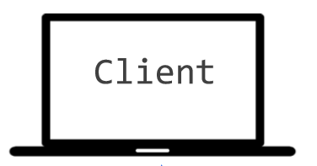

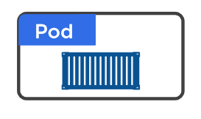
Networking - Service
Why Service?
10.0.10.1
10.0.10.2
10.0.10.3
10.0.10.10
10.0.10.4
Notes:
Why do we have services
Imagine we talk directly… what happens on death?
New pod different IP
<click>

Slide 75
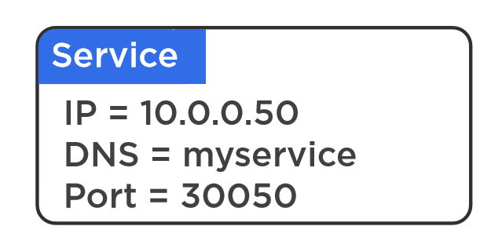
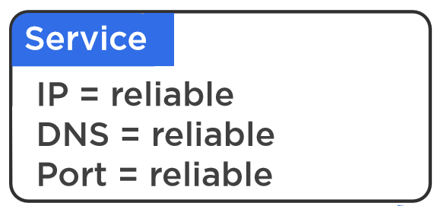
Networking - Service
Why Service?
10.0.10.1
10.0.10.2
10.0.10.3
10.0.10.4
Notes:
Need an abstraction…. With reliable IP/DNS/Port

Slide 76
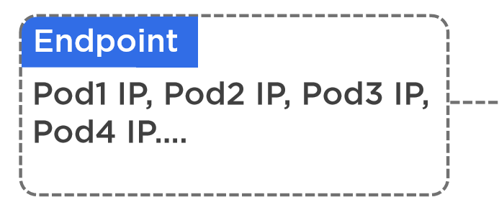
Networking - Service
How Does Service Work
Name : Foo
Type : API
10.0.10.1
10.0.10.2
10.0.10.3
10.0.10.4
10.0.10.5
10.0.10.6
Name : Foo
Name : Foo
Name : Foo
Name : Foo
Name : Bar
Name : Bar
Type : API
Type : API
Type : API
Type : API
Type : Database
Type : Database

Slide 77
Different Types of Services
ClusterIP (default)
LoadBalancer
NodePort
Notes:
ClusterIP == service is completely internal
LoadBalancer == service gets an external IP. AKS will had setting up an external load balancer for you.
NodePort == a primitive way to get external traffic to your service. No longer used even in dev, we won’t be discussing it.

Slide 78
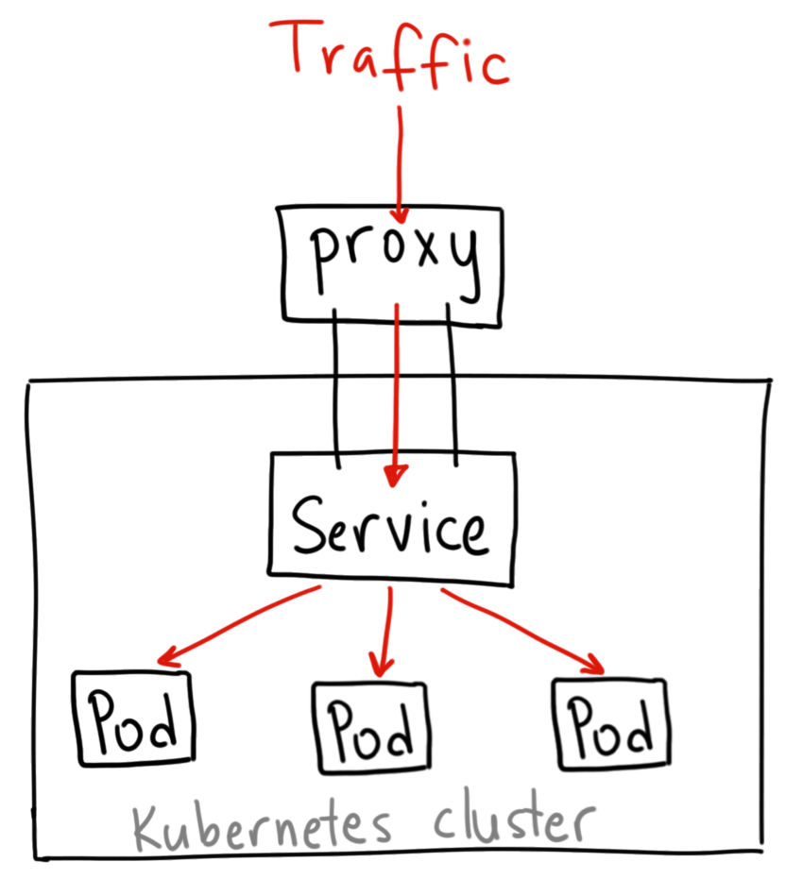
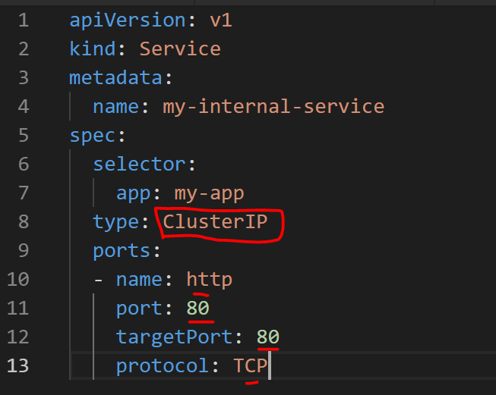
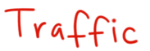
Networking – Service: Cluster IP
How Does ClusterIP Service Work
Notes:
A ClusterIP service is the default Kubernetes service. It gives you a service inside your cluster that other apps inside your cluster can access. There is no external access
When would you use this?
There are a few scenarios where you would use the Kubernetes proxy to access your services.
Grouping pods into subset of services, e.g all Foo API pods , Foo database pods, Foo Web Front Pods etc..
Debugging your services, or connecting to them directly from your laptop for some reason
Allowing internal traffic, displaying internal dashboards, etc.

Slide 79
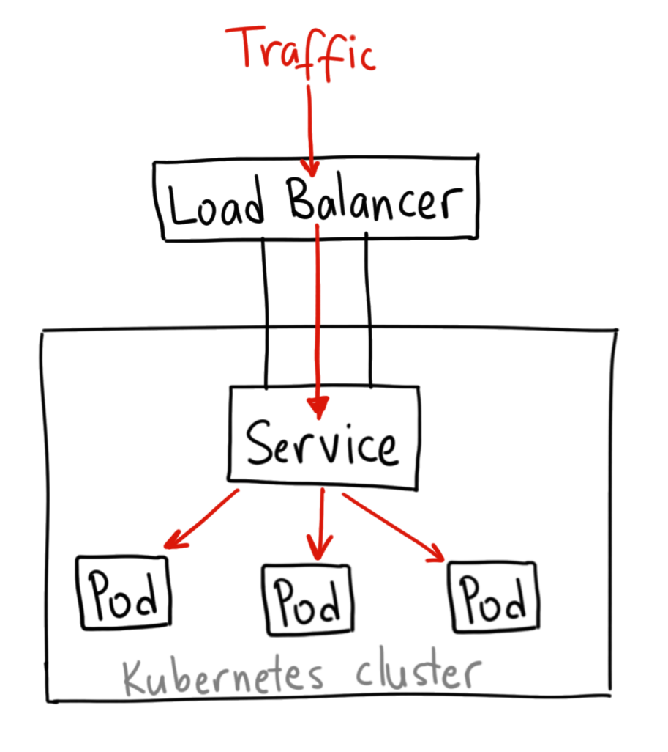
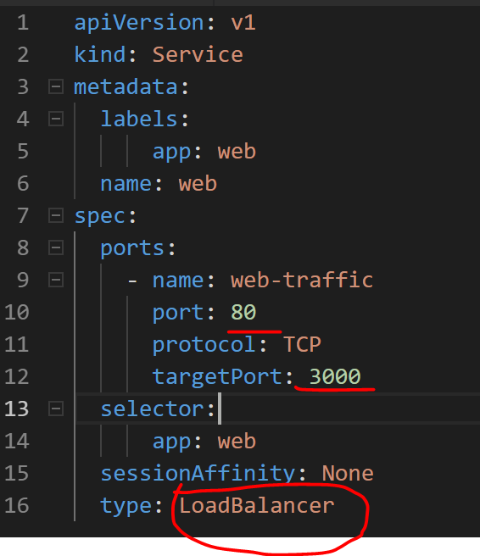
Networking – Service: LoadBalancer
How Does LoadBalancer Service Work
L4
Notes:
LoadBalancer == expose a service to the internet.
A LoadBalancer service is the standard way to expose a service to the internet. On AKS, uses the Azure Load Balancer that will give you a single IP address that will forward all traffic to your service.
When would you use this?
If you want to directly expose a service, this is the default method. All traffic on the port you specify will be forwarded to the service. There is no filtering, no routing, etc. This means you can send almost any kind of traffic to it, like HTTP, TCP, UDP, Websockets, gRPC, or whatever.
The big downside is that each service you expose with a LoadBalancer will get its own IP address, and you have to pay for a LoadBalancer per exposed service, which can get expensive!

Slide 80
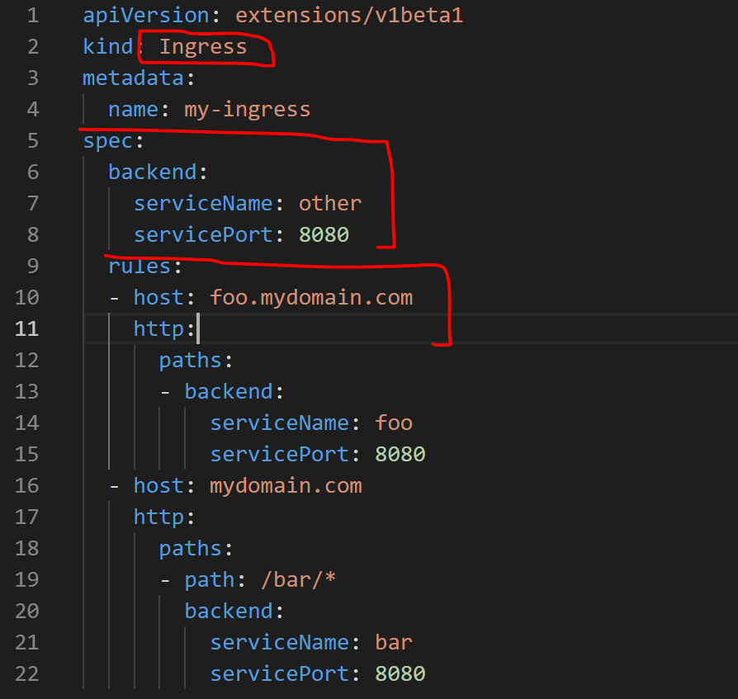
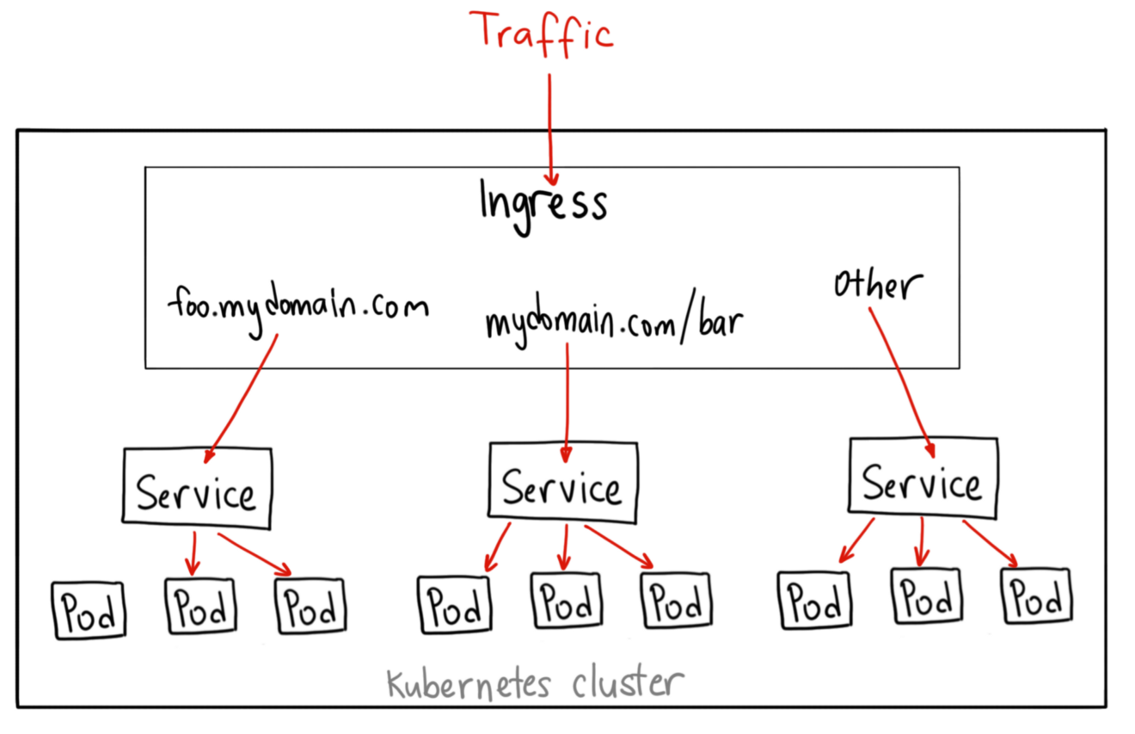
Networking – Ingress APIs
How Does Ingress Controller Work
L7
Notes:
Layer 7
Sub Domain or path reverse proxy
Implementation == Ingress controller
Nginx == industry standard
Azure App Gateway ingress controller now exists too
Unlike all the previous service examples, Ingress is actually NOT a type of service. Instead, it sits in front of multiple services and act as a “smart router” or entrypoint into your cluster.
You can do a lot of different things with an Ingress, and there are many types of Ingress controllers that have different capabilities.
When would you use this?
Ingress is probably the most powerful way to expose your services, but can also be the most complicated. There are many types of Ingress controllers, from the Google Cloud Load Balancer, Nginx, Contour, Istio, and more.
There are also plugins for Ingress controllers, like the cert-manager, that can automatically provision SSL certificates for your services.
Ingress is the most useful if you want to expose multiple services under the same IP address, and these services all use the same L7 protocol (typically HTTP). You only pay for one load balancer if you are using the native GCP integration, and because Ingress is “smart” you can get a lot of features out of the box (like SSL, Auth, Routing, etc)

Slide 81
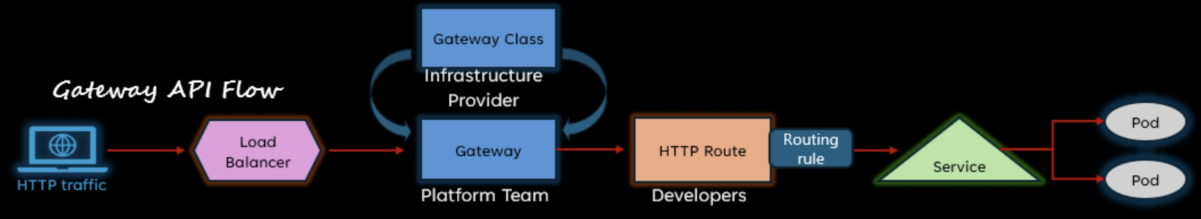
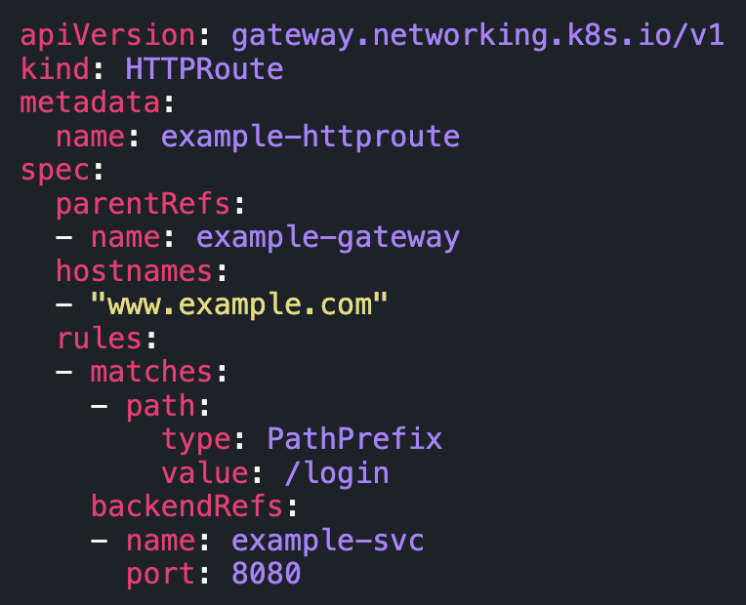
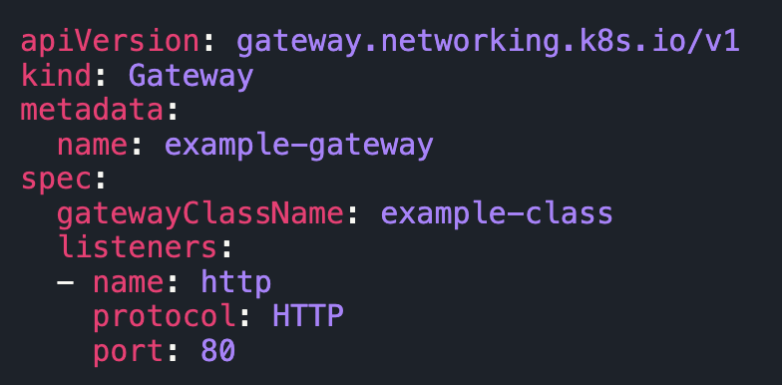
Networking – Gateway APIs
Ingress has some limitations for advanced traffic management features needed in production scenarios (route management cross namespaces, tracing, …) and granular governance → Gateway API were introduced!
Application Gateway for Containers (AG4C)
Istio Ingress Gateway
Notes:
Layer 7
Sub Domain or path reverse proxy
Implementation == Ingress controller
Nginx == industry standard
Azure App Gateway ingress controller now exists too
Unlike all the previous service examples, Ingress is actually NOT a type of service. Instead, it sits in front of multiple services and act as a “smart router” or entrypoint into your cluster.
You can do a lot of different things with an Ingress, and there are many types of Ingress controllers that have different capabilities.
When would you use this?
Ingress is probably the most powerful way to expose your services, but can also be the most complicated. There are many types of Ingress controllers, from the Google Cloud Load Balancer, Nginx, Contour, Istio, and more.
There are also plugins for Ingress controllers, like the cert-manager, that can automatically provision SSL certificates for your services.
Ingress is the most useful if you want to expose multiple services under the same IP address, and these services all use the same L7 protocol (typically HTTP). You only pay for one load balancer if you are using the native GCP integration, and because Ingress is “smart” you can get a lot of features out of the box (like SSL, Auth, Routing, etc)

Slide 82
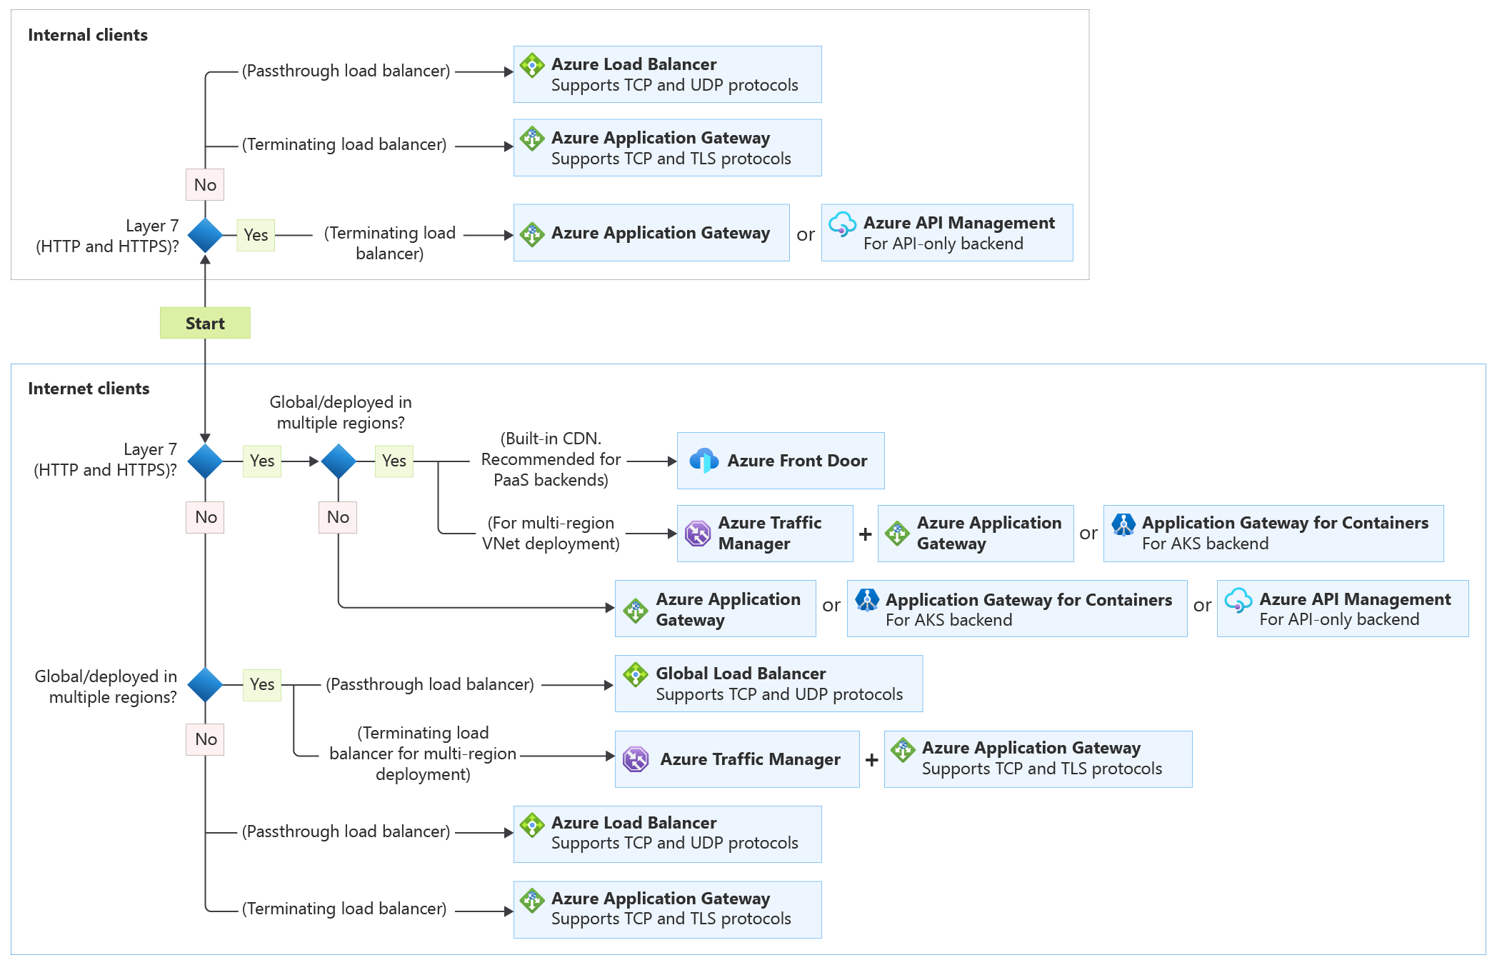
How to help the customer in the choice

Slide 83
AKS networking basics
Customer VNET
Worker node
kube-proxy
Internet
Control plane is deployed in AKS VNET managed by Microsoft
Worker Nodes are VMSS deployed in Customer VNET
CNI – Container Networking interface which allocates an IP to pods and provisions routes/SNAT rules (if any)
Kube-proxy – Provisions networking/LB rules for Services
CoreDNS – Provisions custom dns of services which are internal to the cluster
The 2 VNETs are connected using Azure Private Link Service
VNET managed by Microsoft
Service
Control Plane
Pod
Pod
API server
Containers
Containers
-controller-manager
-scheduler
Worker node
kube-proxy
Internet
replication, namespace, serviceaccounts, etc.
etcd
Pod
Pod
Containers
Containers

Slide 84

Private AKS cluster
Spoke VNET
If the API Server should be reached only from internal network:
Private Endpoint (classic)
Vnet Integration (new)
Consider the existing LZ of the customer before to proceed.
DNS resolution must be in place to resolve the private DNS zone for the control plane endpoint.
Limitations:
Vnet Integration does not support Vnet encryption
Hub VNET
Private Endpoint
OR
VNet Integration
peering
VNET managed by Microsoft
ER
Control Plane
On-prem
API server
-controller-manager
-scheduler
kubectl
replication, namespace, serviceaccounts, etc.
etcd

Slide 85
AKS Networking
Basic / kubenet
Nodes receive IPs from the subnet, Pod does not
Pods cannot communicate each others directly, but using UDR and IP Forwarding (additional hop, added latency)
Windows node pools and virtual nodes not supported
Advanced / Azure CNI
Nodes and Pods receive an IP from the subnet
Pods, Services and Nodes communicate directly
Network address space design is very important
Overlay for saving IPs
Notes:
ACI requires Advanced Networking

Slide 86

AKS Networking
Deprecated!
Will be retired 31.03.2028
Basic / kubenet
Nodes receive IPs from the subnet, Pod does not
Pods cannot communicate each others directly, but using UDR and IP Forwarding (additional hop, added latency)
Windows node pools and virtual nodes not supported
Advanced / Azure CNI
Nodes and Pods receive an IP from the subnet
Pods, Services and Nodes communicate directly
Network address space design is very important
Overlay for saving IPs
https://learn.microsoft.com/en-us/azure/aks/operator-best-practices-network
Notes:
ACI requires Advanced Networking

Slide 87

Container Network Interface (CNI) Overlay or not Overlay?
Notes:
CNCF = Cloud Native Computing Foundation
https://github.com/Azure/azure-container-networking/blob/master/docs/acs.md

Slide 88
Exercise 4
Expose your microservices
Expose the components of the sample app
Make sure that the backend is only accessible from inside the cluster and the frontend is accessible from the outside
15 min

Slide 89

Pause, take a coffee and reflect on… Security!

Slide 90
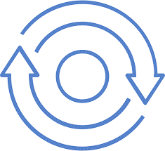

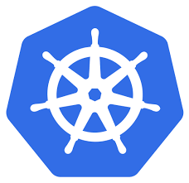
Managed Kubernetes threat factors
CI/CD
Portal/CLI
2. Vulnerable or
misconfigured images
1. Compromised account
Control Plane API
Data Plane API
6. Unauthorized traffic
Kubernetes cluster
API server
Node
Node
Node
4. App level attack
Control Plane
Worker Nodes
5. Node level attack
Provides core Kubernetes services and orchestration of application workloads
Execution of environment
run application workloads
3. Environment misconfiguration

Slide 91
Managed Kubernetes threat factors
CI/CD
Portal/CLI
RBAC integrated with EntraID
2. Vulnerable or
misconfigured images
1. Compromised account
Control Plane API
Data Plane API
6. Unauthorized traffic
Kubernetes cluster
API server
Node
Node
Node
4. App level attack
Control Plane
Worker Nodes
5. Node level attack
Provides core Kubernetes services and orchestration of application workloads
Execution of environment
run application workloads
3. Environment misconfiguration

Slide 92
Managed Kubernetes threat factors
CI/CD
Portal/CLI
Vulnerability assessment with Defender for Container Registry
Image digital signature with Notation and AKV
Image Integrity with Ratify and Azure Policy
2. Vulnerable or
misconfigured images
1. Compromised account
Control Plane API
Data Plane API
6. Unauthorized traffic
Kubernetes cluster
API server
Node
Node
Node
4. App level attack
Control Plane
Worker Nodes
5. Node level attack
Provides core Kubernetes services and orchestration of application workloads
Execution of environment
run application workloads
3. Environment misconfiguration

Slide 93
Managed Kubernetes threat factors
CI/CD
Portal/CLI
2. Vulnerable or
misconfigured images
1. Compromised account
Control Plane API
Data Plane API
6. Unauthorized traffic
Kubernetes cluster
API server
Node
Node
Node
4. App level attack
Control Plane
Worker Nodes
5. Node level attack
Provides core Kubernetes services and orchestration of application workloads
Execution of environment
run application workloads
Defender for Container
Azure Policies
GitOps for cluster configuration
3. Environment misconfiguration

Slide 94
Managed Kubernetes threat factors
CI/CD
Portal/CLI
2. Vulnerable or
misconfigured images
1. Compromised account
Control Plane API
Data Plane API
6. Unauthorized traffic
Kubernetes cluster
Pod identity with Entra ID
Pod Sanboxing
Secrets and keys in AKV
API server
Node
Node
Node
4. App level attack
Control Plane
Worker Nodes
5. Node level attack
Provides core Kubernetes services and orchestration of application workloads
Execution of environment
run application workloads
3. Environment misconfiguration

Slide 95
Managed Kubernetes threat factors
CI/CD
Portal/CLI
2. Vulnerable or
misconfigured images
1. Compromised account
Control Plane API
Data Plane API
6. Unauthorized traffic
Kubernetes cluster
API server
Node
Node
Node
Automatic Upgrades
Private IP only
SSH/RDP disabled
4. App level attack
Control Plane
Worker Nodes
5. Node level attack
Provides core Kubernetes services and orchestration of application workloads
Execution of environment
run application workloads
3. Environment misconfiguration

Slide 96
Managed Kubernetes threat factors
NSG
WAF
Azure Policies powered by Cilium or Calico
CI/CD
Portal/CLI
2. Vulnerable or
misconfigured images
1. Compromised account
Control Plane API
Data Plane API
6. Unauthorized traffic
Kubernetes cluster
API server
Node
Node
Node
4. App level attack
Control Plane
Worker Nodes
5. Node level attack
Provides core Kubernetes services and orchestration of application workloads
Execution of environment
run application workloads
3. Environment misconfiguration

Slide 97
Scaling

Slide 98
Scaling Pods
Cluster
Control Plane
Node
Node
Node
Kube stuff
Kube stuff
Kube stuff
Kube stuff
Pod
ratings-web1
Pod
ratings-web3
Pod
ratings-web5
*Azure Managed
Deployment
SCALE pods!
Pod
ratings-web2
Pod
ratings-web4
Pod
ratings-web6
Notes:
Here’s what a rolling update looks like if we update the deployment with new a new version of the app

Slide 99
Scaling Nodes
Cluster
Control Plane
Node
Node
Node
Node
Kube stuff
Kube stuff
Kube stuff
Kube stuff
Kube stuff
Pod
ratings-web1
Pod
ratings-web2
Pod
ratings-web3
Pod
ratings-web4
*Azure Managed
Pod
ratings-api1
Pod
ratings-api2
Pod
ratings-api3
Pod
ratings-web5
az aks scale –name myAKSCluster –g myRG –node-count 4
Notes:
K8S doesn’t manage infrastructure!
You would need to stand up VMs, manually (or scripted) install all the “kube stuff” in the black boxes
Log into the master and add those things
Here’s what it looks like to scale nodes, and then pods!
If K8S was in a state where it had NO resources, it would just fulfill its desired state destiny!

Slide 100

Exercise 5
20 min
Scale ‘er up!!!
Understand the scaling options in AKS
Scale manually and automatically the backend microservice
Testing scalability of the cluster
Tip! What happens to the backend data
when the service scales?

Slide 101
Storage

Slide 102


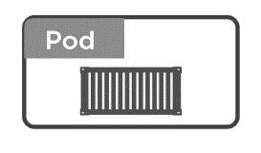
Volumes in Kubernetes
Why we need volumes?
On-disk files in a Container
are
ephemeral
Volume
(state)
Notes:
2 clicks
If pods dies, data dies
Pods only get ephemeral storage
What happens if you need persistence across lifecycle
VOLUMES!

Slide 103
Volumes in Kubernetes
Different Types
Volumes
emptyDir
hostPath
Cloud Volumes
Persisted Volum Claim (PVC)
ConfigMap
Security
….
RAM
HDD /SSD
Notes:
hostPath = folder on node (single node testing only)
<click>

Slide 104
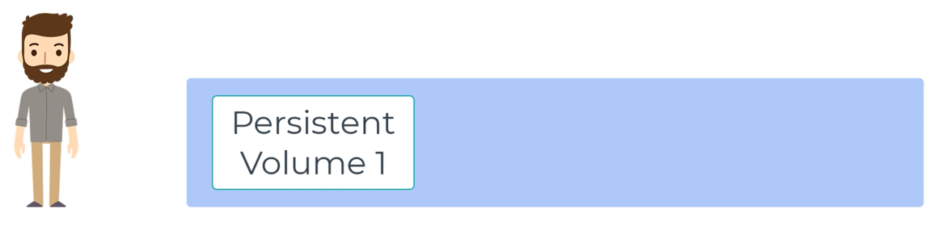
Persistent Volumes - Static
Notes:
PV is storage provisioned by admin.

Slide 105
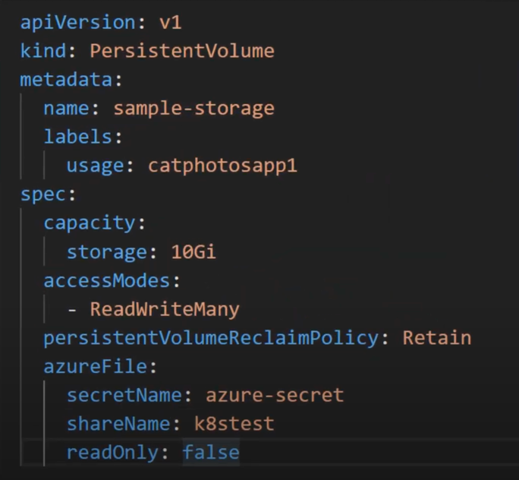
Persistent Volumes - Static
Notes:
PV is storage provisioned by admin.

Slide 106
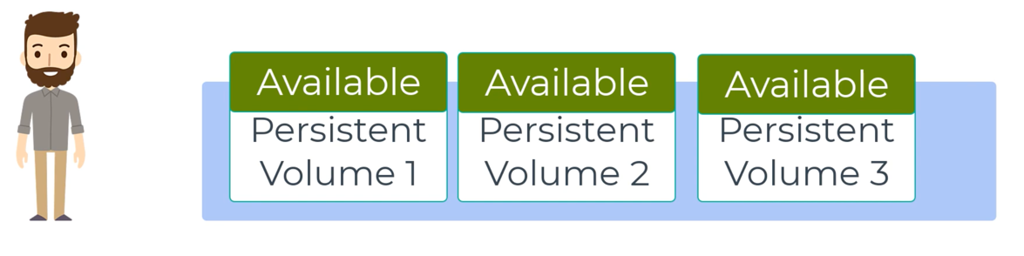
Persistent Volumes - Static
Notes:
PV is storage provisioned by admin.
Cluster of disks like we have a cluster of VMs.

Slide 107
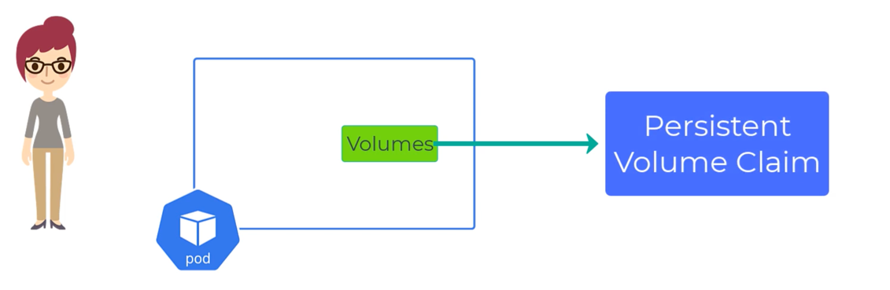
Persistent Volume Claims
Notes:
PVC is a request for storage of certain size and type
Just like: pods with their cpu and memory requests

Slide 108

Persistent Volume Claims
Notes:
PVC is a request for storage of certain size and type
Just like: pods with their cpu and memory requests

Slide 109

Persistent Volume Claims
Notes:
PVC will search for a PV that matches its needs.
It will remain in Pending state until it does.

Slide 110

Persistent Volume Claims
Notes:
Once a suitable PV is found, the PVC is “Bound” to the PV

Slide 111

Persistent Volume Claims
Notes:
The reclaim policy tells us what happens to the PV when the PVC is deleted

Slide 112

Persistent Volume Claims
Notes:
The reclaim policy tells us what happens to the PV when the PVC is deleted.
Cluster admin set this when they set up the PV cluster.

Slide 113

Persistent Volumes
Notes:
How do we make this more dynamic???

Slide 114

Persistent Volumes - Dynamic
Notes:
… storage classes.

Slide 115

Persistent Volumes - Dynamic
Notes:
When we create a PVC with a storage class, the SC will make sure to dynamically create the type of storage we want.

Slide 116

Persistent Volumes - Dynamic
Notes:
There are various storage clusters that come with AKS and more can be created.

Slide 117

Persistent Volumes - Dynamic
Notes:
Once the PV asks for a managed-premium disk it is provisioned automatically
Ops doesn’t need to be involved.
It will be the exact size asked for
The default retainPolicy is “DELETE”

Slide 118
Exercise 6
Storage
Verify data are not persisted on the backend service
Configure Azure Disks as persistent storage for the backend service
Test the new configuration
30 min

Slide 119

Mmh, but what about scaling stateful workload??

Slide 120
Write options
Node 1
Node 2
Node 1
Node 2
Node 1
Node 2
Pod 1
Pod 2
Pod 1
Pod 2
Pod 1
Pod 2
Read/Write
Read/Write
Read/Write
Read/Write
Read/Write
Read
X
Write
Azure Disk
Azure Disk
Azure Disk
Azure File
RWO
ROX
RWX
Notes:
Once the PV asks for a managed-premium disk it is provisioned automatically
Ops doesn’t need to be involved.
It will be the exact size asked for
The default retainPolicy is “DELETE”

Slide 121

Congrats, you successfully complete the PoC!

Slide 122
And now, some Day-2 ops!

Slide 123
HA / BC / DR

Slide 124
AKS Provides a highly scalable, reliable and resilient platform
Node Auto repair
Kube-apiserver uptime SLA
Native Backup integrations
End to End Auto-scaling
Multi-region workloads with Fleet
Zonal resilient and Autoscaling control plane

Slide 125

HA & DR
Regional

Slide 126

HA & DR
Multi-Regional

Slide 127

Backup
Enable 3-2-1 Backup Strategy by storing data for long term and build compliant applications
Now backup your AKS applications and securely store them in a Vault offsite.
Move backup data stored as snapshots to a low-cost storage tier and retain it for up to 10 years to meet your compliance needs.
Protect your backups against malicious actors and ransomware threats using features such as Customer Managed Keys (CMK) encryption, Soft Delete, Immutability, and Multi-User Authorization.
Utilize your backups in the event of regional outages and restore your applications in a different region.

Slide 128
Exercise 7
Backup
Prepare storage container and vault
Enable the Backup add-on in your cluster
Run a manual backup to test restoring in another region

Slide 129
What customers want
Reliability
zone redundancy
geo-replication
But, containing costs
Discuss about the requirement for RTO/RPO!

Slide 130
Monitoring & Logging

Slide 131

Cloud Native monitoring

Slide 132
Monitoring
What Indicators Matter in Kubernetes
Network flow of IP traffic through NSG to the cluster
Cluster health: total number of nodes, pods, etc
Node health: available compute resources, health
Application health
Tooling Examples
Prometheus
App Insights
Azure Monitor
Grafana for visualization
Notes:
https://docs.datadoghq.com/integrations/kubernetes/

Slide 133
Logging
Pod logs: applications must log to standard out!
Cluster-wide event logs
Control plane logs
Custom forwarder (if needed)
Log indexers
Log Analytics
Splunk
ELK stack
Azure Data Explorer

Slide 134
What customers want
Multi-tenant clusters logging segregation
Optimize Costs / reduce logs retained
Export logs/metrics to 3rd party systems
Creating alert
Integration with DevOps tools

Slide 135
Exercise 8
Deploying Monitoring Tools and Troubleshooting
Review the Container Insights
Enable Dashboard with Grafana

Slide 136

And now…

